Slide 1

Using Machine Learning to Predict Heart Disease
Group 2
Yonatan Gorin
Desiree Joseph
BethAnn Wilde
June 12, 2023

Slide 2

Heart Disease in the United States Heart disease is the leading cause of death for men, women, and people of most racial and ethnic groups in the United States. One person dies every 33 seconds in the United States from cardiovascular disease.¹ About 695,000 people in the United States died from heart disease in 2021—that’s 1 in every 5 deaths. Heart disease cost the United States about $239.9 billion each year from 2018 to 2019. This includes the cost of health care services, medicines, and lost productivity due to death. Heart Disease Facts | cdc.gov

Slide 3
Using Machine Learning to Predict Heart Disease, the process
Found dataset related to heart disease
Review dataset to understand different factors and relationships to features and heart disease
Create Machine Learning models to Predict Heart Disease
A look at the results of Predicting Heart Disease

Slide 4
Machine Learning and Heart Disease Dataset
Kagger Heart Disease: This data set dates from 1988 and consists of four databases: Cleveland, Hungary, Switzerland, and Long Beach V.
Features:
age
sex
chest pain type (4 values)
resting blood pressure
serum cholestoral in mg/dl
fasting blood sugar > 120 mg/dl
resting electrocardiographic results (values 0,1,2)
maximum heart rate achieved
exercise induced angina
oldpeak = ST depression induced by exercise relative to rest
the slope of the peak exercise ST segment
number of major vessels (0-3) colored by flourosopy
thal: 0 = normal; 1 = fixed defect; 2 = reversable defect

Slide 5
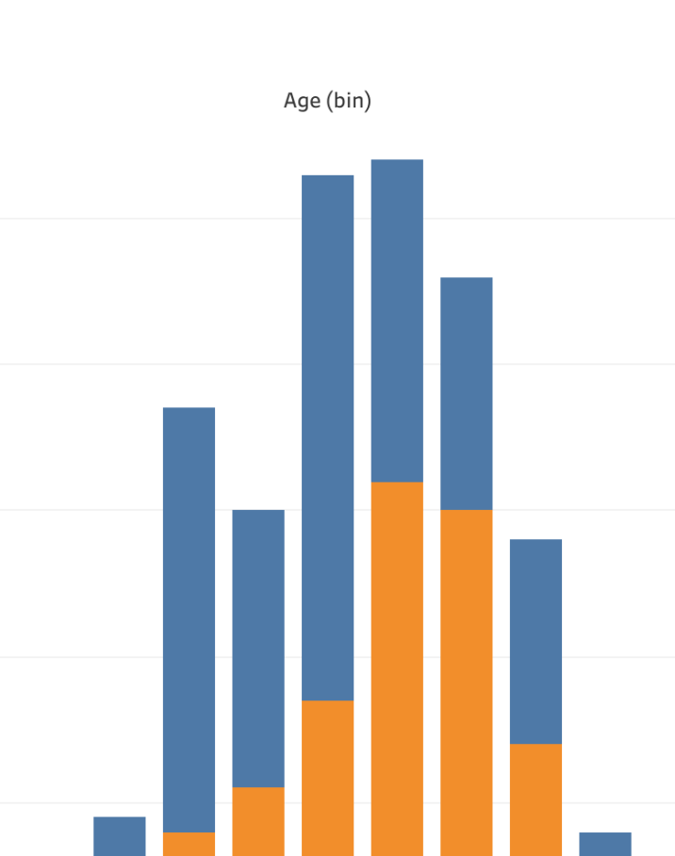
Looking at the Data
Tableau storybook tell the story
https://public.tableau.com/views/HeartDisease_16861664220970/Sheet1?:language=en-US&:display_count=n&:origin=viz_share_link

Slide 6
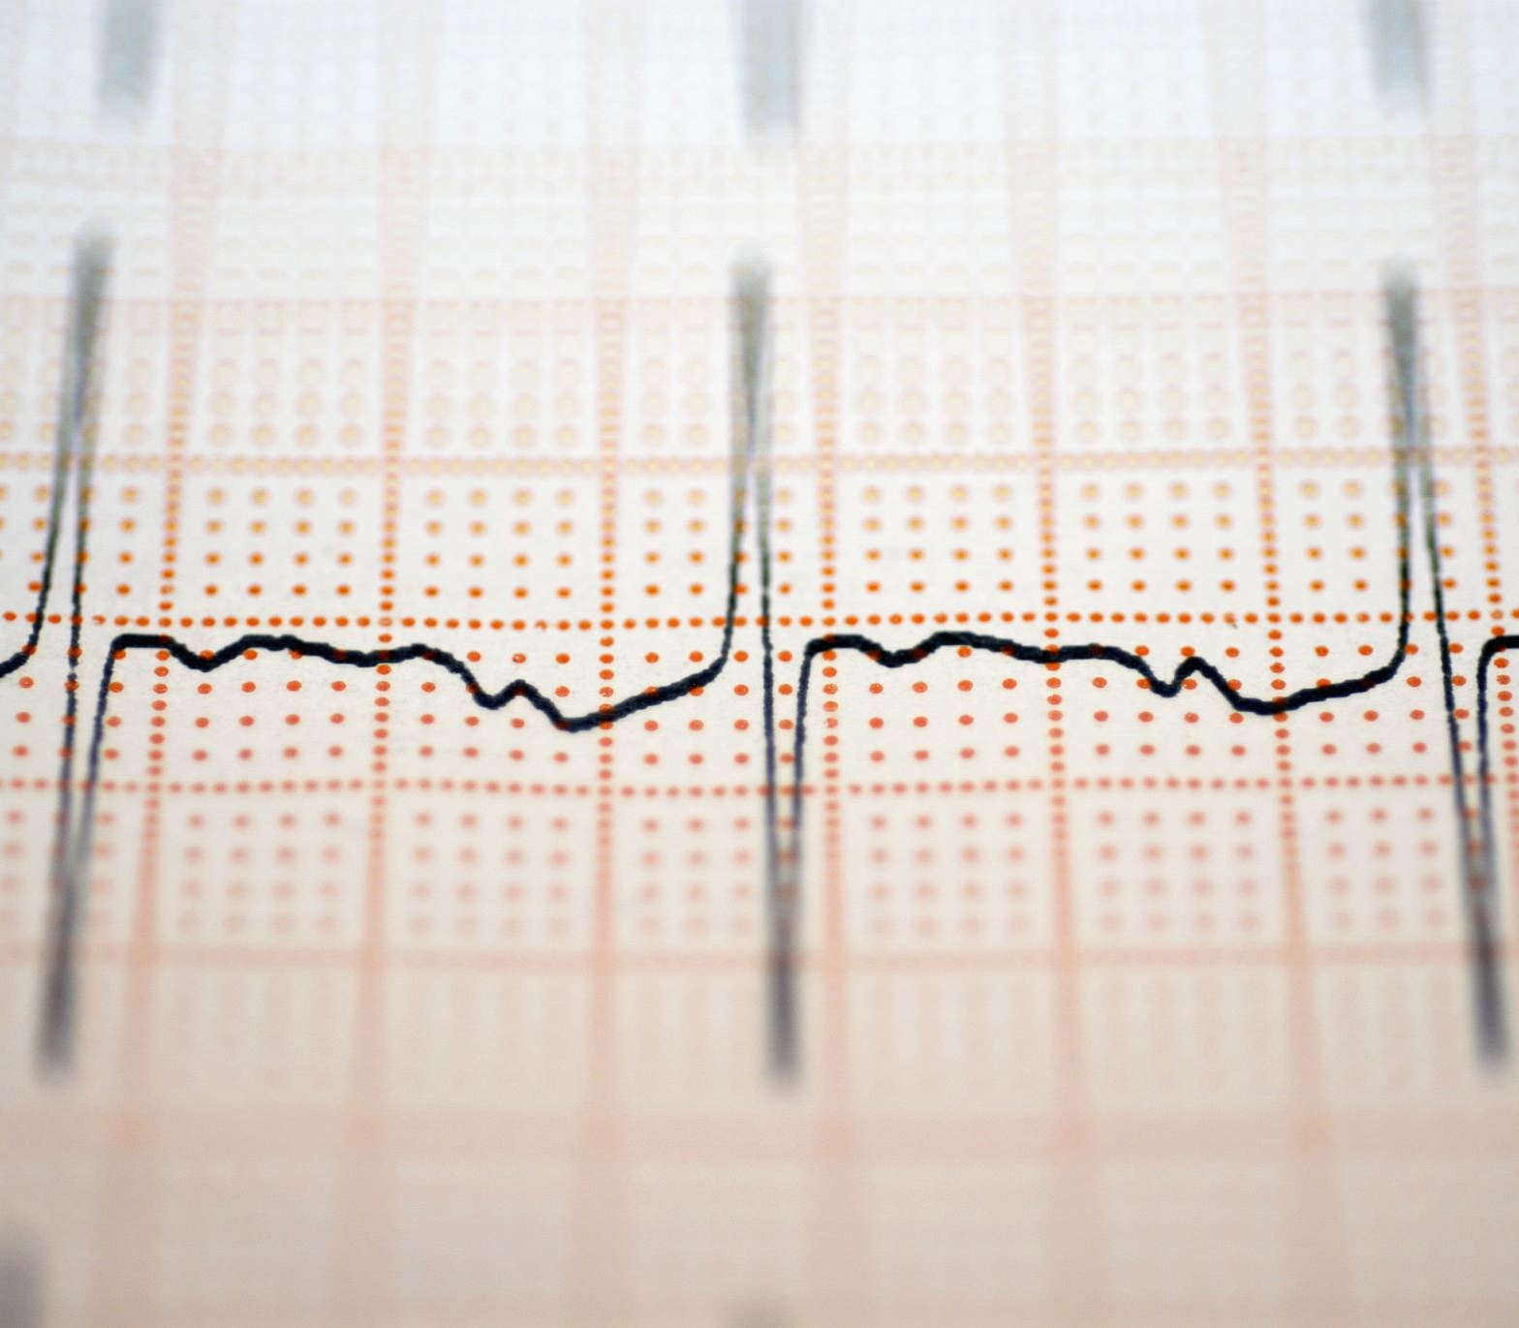
Multiple Models were created to determine which was the most effective to Predict Heart Disease
Supervised Learning Models:
Logistic Regression
Random Forest
Decision Tree
Support Vector Machine (SVM)
Neural Networks:
Sequential
Keras Tuner

Slide 7
Logistic Regression
Accuracy score .78

Slide 8
Random Forest
Accuracy Score : 0.8382352941176471

Slide 9
Decision Tree
Accuracy Score : 0.7058823529411765

Slide 10
Support Vector Machine (SVM)
Confusion Metrix
.89

Slide 11
Sequential
Accuracy: 0.8529411554336548

Slide 12
Keras Tuner
Accuracy: 0.8970588445663452

